Slide 1














CRIMINAL RECORD MANAGEMENT SYSTEM
Presented by
PRASHANT YADAV
UE233075
PRATHAM MAHAJAN
UE233076
PRASHANT CHAUDHARY
UE233074
PRASHANT BHATI
UE233073
MUKUL BHARDWAJ
UE233066
PRIYANSHU YADAV
UEM233126

Slide 2
Purpose of the Project
Centralized storage and easy retrieval of criminal records.
Enhanced data security through role-based access control.
Reducing paperwork and minimizing errors in record-keeping.
Efficient search and filtering for quick identification of suspects.
Tracking case histories, evidence, and court proceedings.
Facilitating collaboration across police departments.
Providing analytics for crime trends and prevention strategies.
3
Presentation title
20XX

Slide 3

ER Diagram
The Entity-Relationship (ER) Diagram is a visual representation of the database structure for the Criminal Records Management System. It illustrates how various entities within the system are connected and interact with each other.
4

Slide 4



gender
contact
address
case_incharge
description
location
fiir registered against criminal
age
criminal
criminal_id
Fir
criminal_invloved
status
pending_cases
station__no
station_name
father_name
criminal_name
date_of_fir
fir_id
prisoners_num
station
contact
evidence registered in
address
sho_name
policemen_num
police_id
works in
fir_id
address
police_name
evidence_id
type
evidence collected by
police_men
Evidence
rank
contact
desription
sation_no
fir handled by policemen
father_name
date_collected
gender
date_of_birth
collected_by

Slide 5
Relational Data Model
STATION
Station_no | PK
station_name
contact
address
policemen_num
sho_name
prisonners_num
pending_cases
CRIMINAL
criminal_id | PK
criminal_name
father_name
age
gender
contact
address
EVIDENCE
evidence_id | PK
fir_id | FK
description
date_collected
collected_by | FK
POLICE_MAN
police_id | PK
police_name
contact_number
father_name
date_of_birth
gender
rank
address
station_no | FK
FIR
Fir_id | PK
date_of_fir
status
loacation
description
case_incharge | FK
criminal_involved | FK

Slide 6
Introduction
What is the Criminal record management system?
A PL/SQL package designed to streamline law enforcement operations and maintain accurate records of criminal activities.
The Criminal Record Management System is a robust solution developed using PL/SQL, tailored to efficiently manage the operations of law enforcement agencies. This system centralizes and organizes essential tasks such as maintaining criminal records, managing FIRs (First Information Reports), assigning cases to officers, handling evidence, and tracking police station data. By automating and integrating these processes, it ensures seamless operations, accurate record-keeping, and quick access to crucial information, thus enhancing overall efficiency in criminal justice administration.

Slide 7
Features of Criminal Management Package
Encapsulation of Logic:
Combines multiple related procedures and functions into one package, simplifying database management.
Reduces redundancy and ensures easier maintenance and scalability.
Procedural Operations:
Provides predefined procedures to add, update, and remove records in the database, streamlining core functionalities.
Handles records for police stations, police personnel, criminals, FIRs, and evidence.
Custom Functions:
Includes functions like get_station_info to retrieve specific data (e.g., details of a police station) in a concise and structured format.
Error Minimization:
Ensures accurate data manipulation by enforcing predefined business logic through the package.
Reusability:
Offers reusable code for common operations, reducing the need to write SQL queries repeatedly.
Scalable and Modular Design:
Designed to accommodate additional functionalities in the future by adding more procedures or functions to the package.
Security and Data Integrity:
Allows centralized control over operations, ensuring secure and consistent data handling.
Enforces database constraints and relationships between tables seamlessly.

Slide 8
Features ofCriminal Management Package
Adding Records:
add_station: Inserts a new police station with its details into the database.
add_policeman: Adds details of a police officer to the relevant station.
add_fir: Registers a new FIR with case details and links it to the responsible officer and involved criminal.
add_criminal: Adds a criminal’s personal information and unique identifier.
add_evidence: Records evidence collected in a case, associating it with the relevant FIR and officer.
Updating Records:
update_fir_status: Updates the status of an FIR, such as from 'Pending' to 'Resolved'.
update_policeman_rank: Modifies the rank of a police officer, such as during promotions or role changes.
Removing Records:
remove_fir: Deletes an FIR record and all associated information from the database.
remove_criminal: Removes a criminal's record from the database.
Data Retrieval:
get_station_info: Retrieves information about a police station, such as its name and Station House Officer (SHO).
Efficient Sequence Management:
Automatically generates unique IDs for FIRs, criminals, and evidence using predefined sequences.

Slide 9

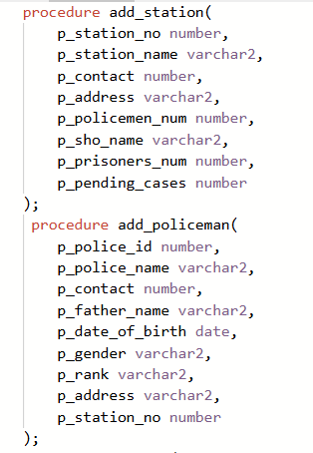
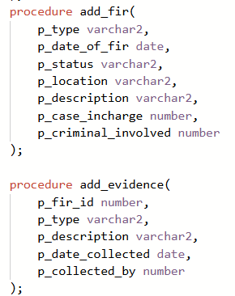
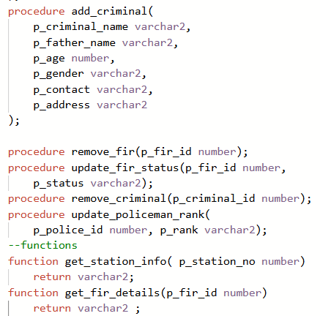
Features ofCriminal Management Package
Package Specification

Slide 10
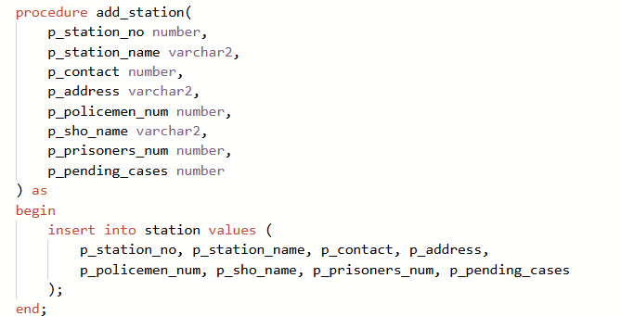
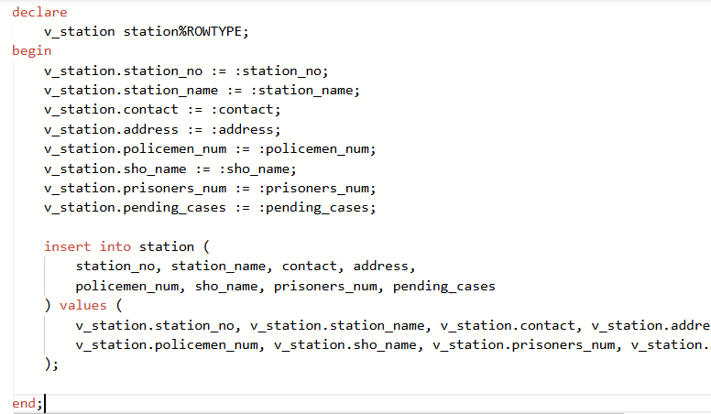
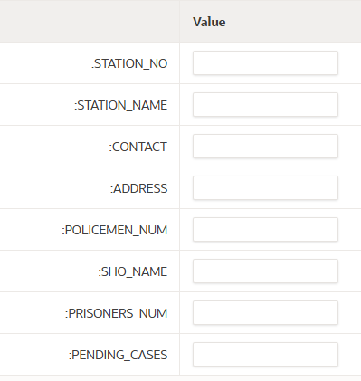
Procedures
1)add_station
Adds a new police station to the database.
Stores the station's name, address, contact number, and the Station House Officer (SHO).
Ensures the station is assigned a unique identifier for efficient record management.

Slide 11
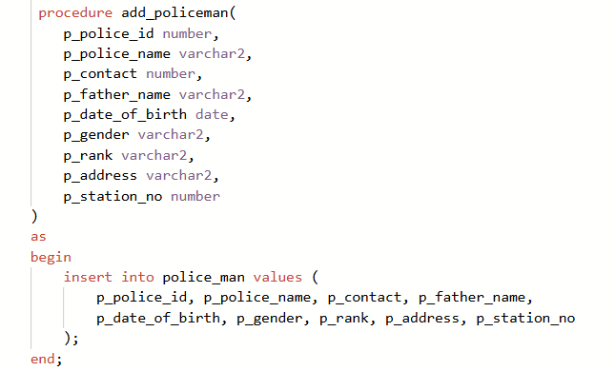
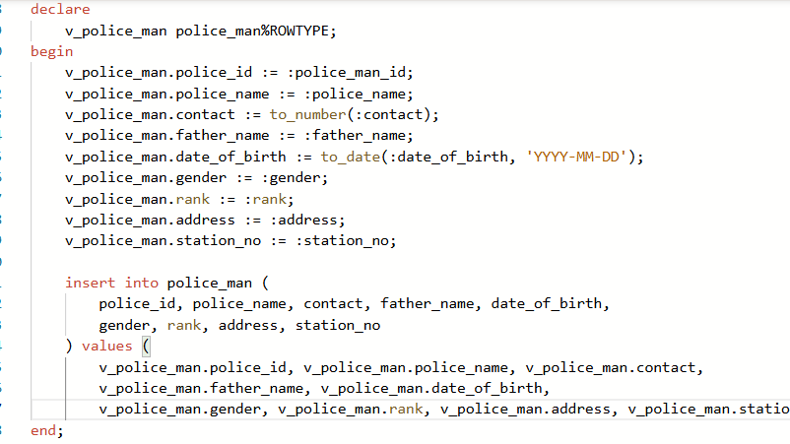
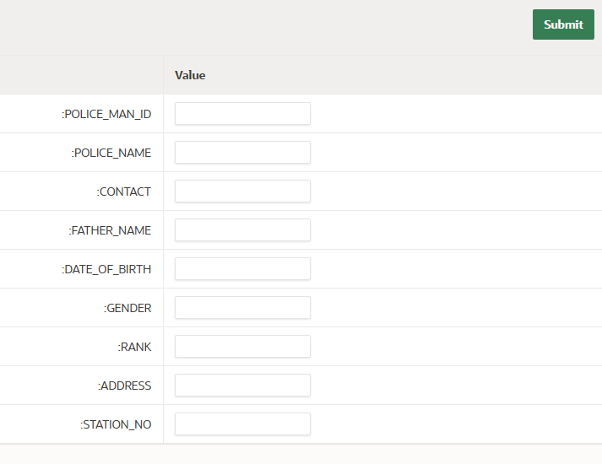
Procedures
2)add_policeman
Adds a new police officer to a specific station.
Captures details such as name, rank, joining date, and contact information.
Links the officer to their assigned station using the station's unique identifier.

Slide 12
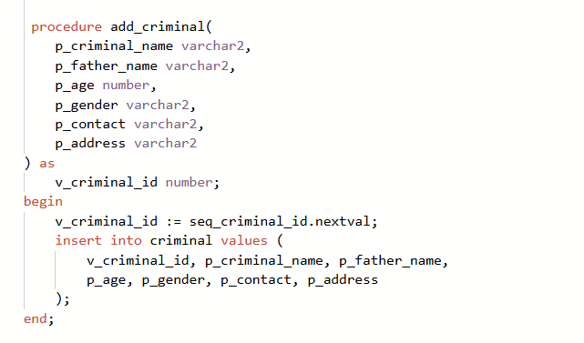
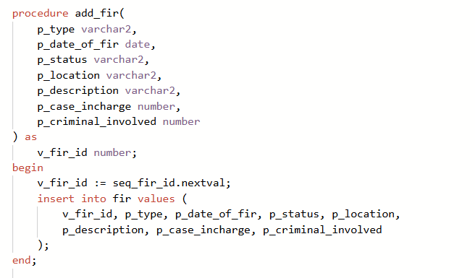
Procedures
3)add_criminal
Adds a new criminal's details to the database.
Captures personal information like name, age, address, and criminal record history.
Assigns a unique criminal ID using an auto-increment sequence for identification.
4. add_fir
Records a new First Information Report (FIR) in the database.
Includes details such as the filing date, crime description, responsible officer, and associated criminal(s).
Assigns the FIR a unique number for tracking.

Slide 13
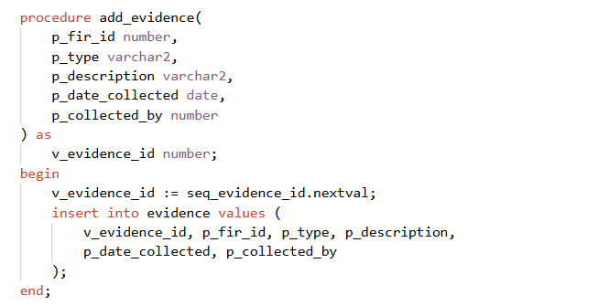
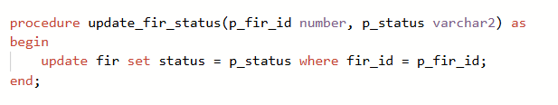
Procedures
5)add_evidence
Records evidence linked to a specific FIR.
Captures evidence details, including type, description, and date collected.
Links the evidence to its corresponding FIR and the officer responsible.
6)update_fir_status
Updates the status of an FIR in the database.
Statuses can include "Pending," "Under Investigation," or "Resolved."
Ensures the timeline and resolution details are accurately reflected.

Slide 14
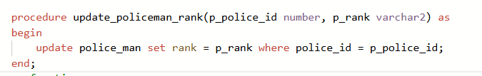
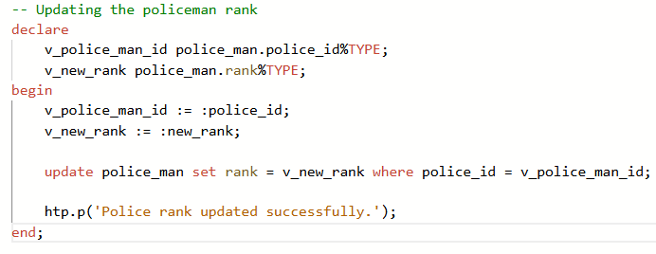
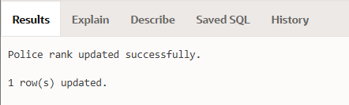
Procedures
7)update_policemen_rank
Updates the rank of a police officer in the database.
Reflects changes such as promotions or role transitions.

Slide 15
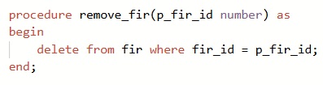
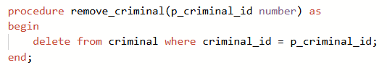
Procedures
8)remove_fir
Removes FIR from the database of police if the person wants to take back his FIR.
Ensures that the evidences and the criminal records related to the fir are also deleted.
9)remove_criminal
Deletes a criminal's record from the database.
Ensures all associated FIRs and evidence are managed appropriately during the deletion.

Slide 16

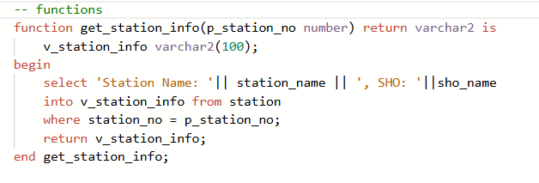
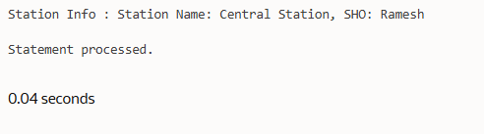
FUNCTIONS
1) get_station_info
Displays the information of any station.
The station number is passed as a parameter.
It displays the name of the station and name of the SHO of that station

Slide 17
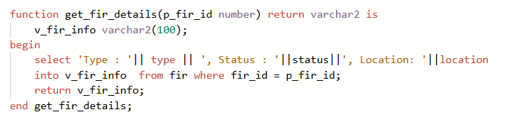
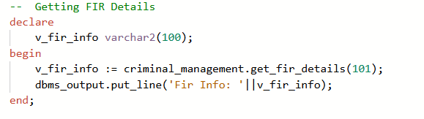
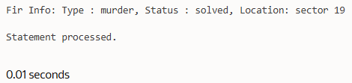
FUNCTIONS
2) get_fir_details
Displays the information of any desired FIR
The FIR ID is passed as a parameter.
It displays the type of crime , status of FIR and and place of crime .

Slide 18
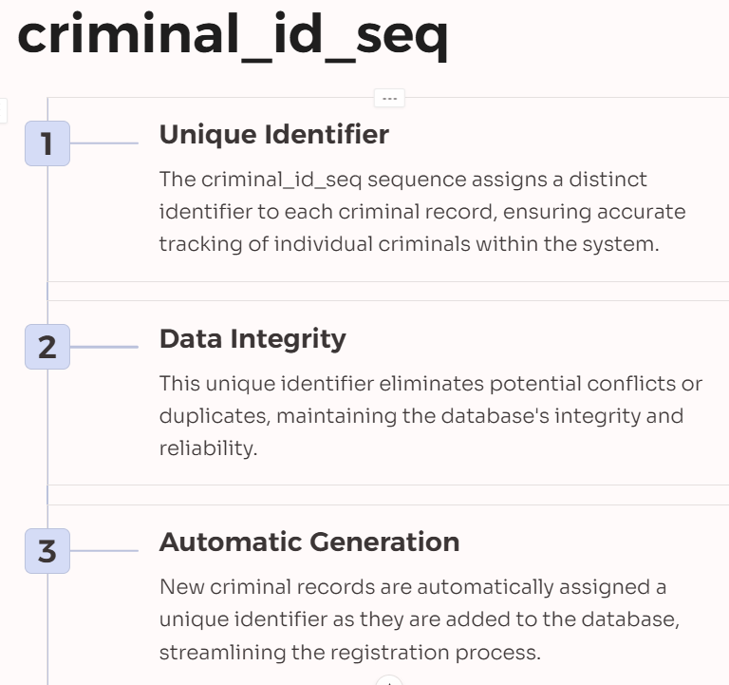
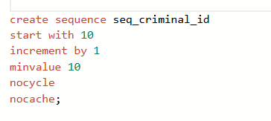
SEQUENCES
seq_criminal_id

Slide 19
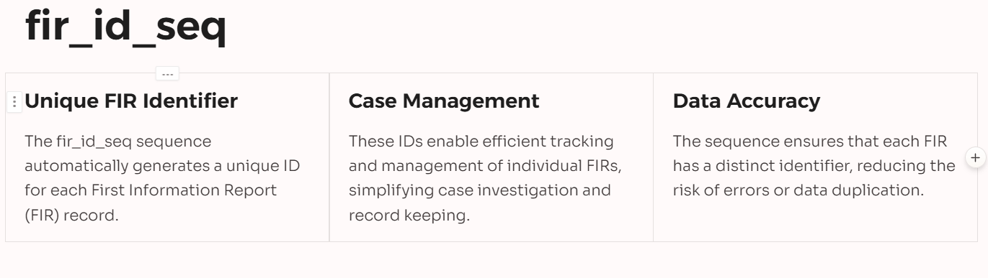
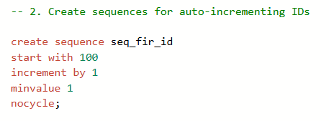
SEQUENCES
seq_fir_id

Slide 20
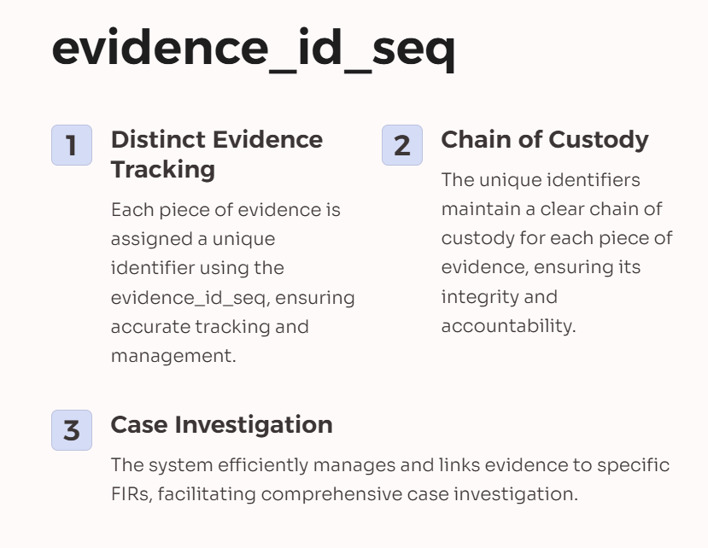
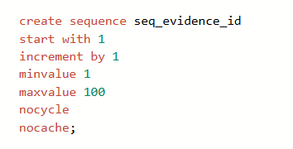
SEQUENCES
seq_evidence_id

Slide 21
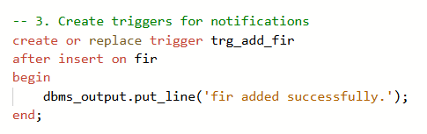
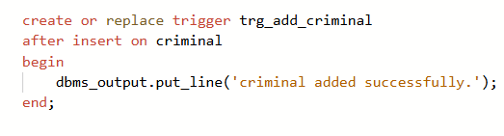
TRIGGERS
1) trg_add_fir
This triggers gets activated after a new FIR is created .
This trigger displays the following output on the output terminal
“fir added successfully”.
2) trg_add_criminal
This triggers gets activated after a new criminal is added in the database .
This trigger displays the following output on the output terminal
“criminal added successfully”.

Slide 22
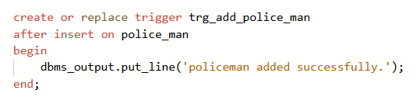
TRIGGERS
3) trg_add_police_man
This triggers gets activated after a new policeman is added to the database.
This trigger displays the following output on the output terminal
“Policeman added successfully”.

Slide 23
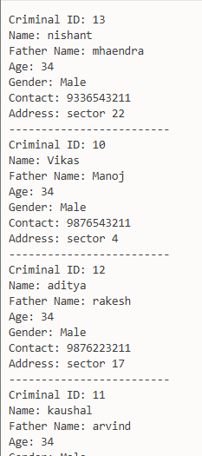
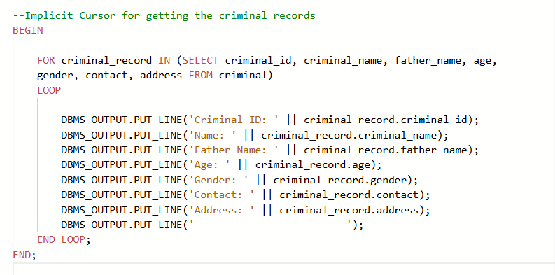
CURSORS
Implicit Cursor:-

Slide 24
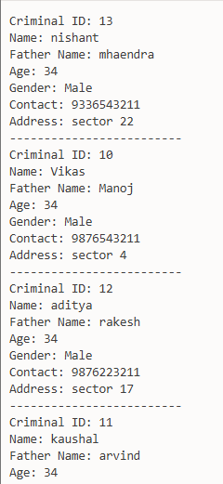
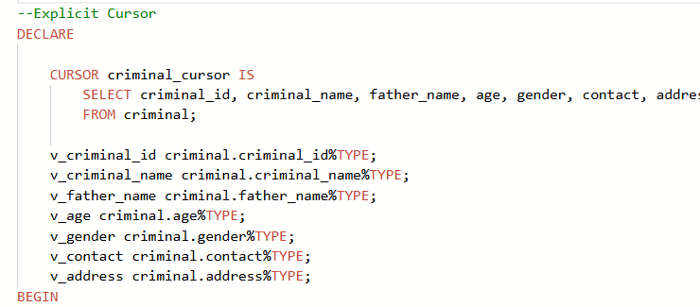
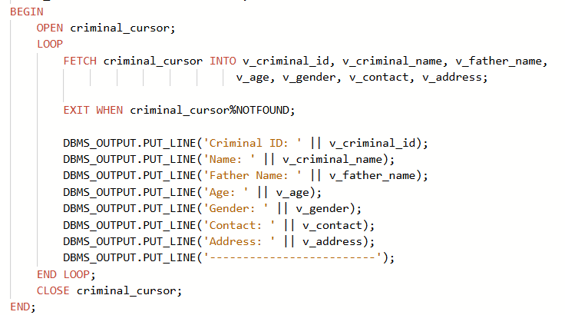
CURSORS
Explicit Cursor:-

Slide 25
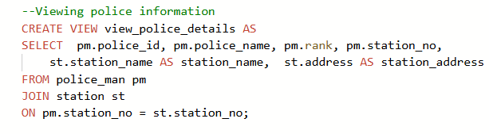
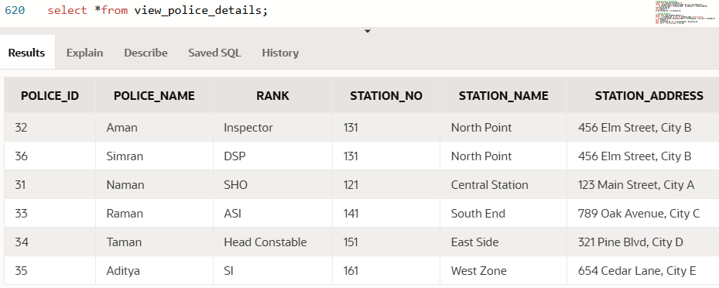
VIEWS
1) view_police_details
This view is used to display the police man table including the following columns police_id , police_name , rank , station_no , station_name , station_address.

Slide 26
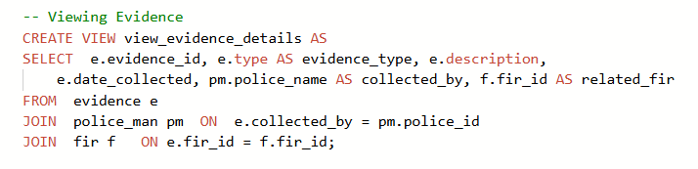
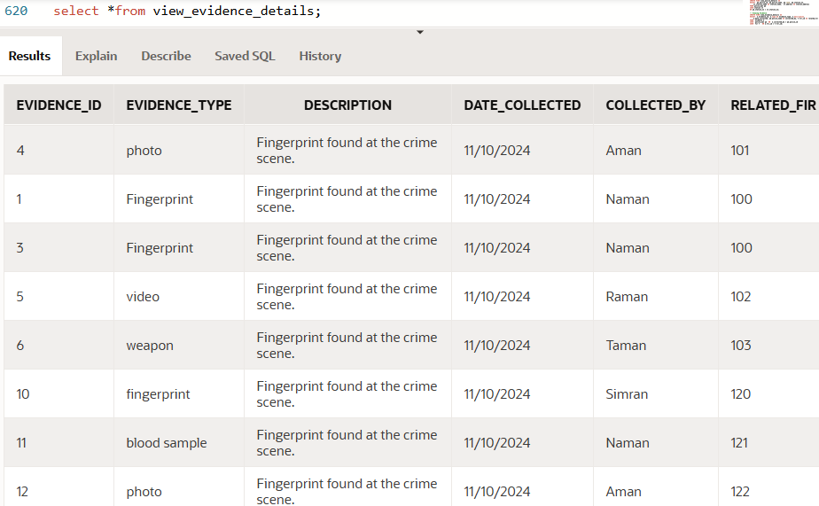
VIEWS
2) view_evidence_details
This view is used to display the evidennce table including the following columns evidence_id , evidence_type , description , date_collected , collected_by and related_fir number.

Slide 27
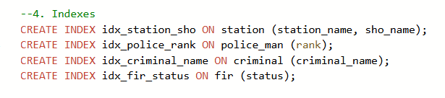
Indexes
1) idx_station_sho
2) idx_police_rank
3) idx_criminal_name
4) idx_fir_status

Slide 28
SUMMARY
The Criminal Record Management System Database is an efficient, automated solution that streamlines law enforcement operations. By centralizing critical information regarding criminals, FIRs, investigations, and officers, it enhances data accessibility, reduces errors, and improves decision-making. Through its use of PL/SQL, sequences, views, and indexes, the system provides a high level of functionality, performance, and scalability suitable for modern law enforcement agencies.

Slide 29



THANK
YOU

